Slide 1
Faculty Senate Meeting
September 22, 2022

Slide 2
Meeting procedure
The same rules apply over virtual meetings as over in-person meetings
Only Senators may debate motions
Only Senators can vote
If you are not a Senator, or a proxy, you cannot vote or debate
Do not speak over someone, or out of order
Raise your hand within the Zoom app
The President may call on you and then you will have the floor
Unless you have been recognized (been told you have the floor), you may not speak

Slide 3
Meeting Minutes
We will be using Robert's Rules to guide our recording of minutes.
Robert's Rules of Order say that meeting minutes are simply a summary of what happened at the meeting.
They are not a play by play of everything that happened or what members said.
If needed, Faculty Senators may request access to the audio recording of the meeting. Please email facsenate@mst.edu with justification.

Slide 4
Agenda
Call to Order and Roll Call
D. Westenberg, Secretary

Slide 5
Agenda
Approval of Minutes
June 9, 2022

Slide 6
Agenda
III. President’s Report
K. Sheppard

Slide 7
Resolution, Dr. Kelly Homan
Whereas Professor Kelly Homan has served the Faculty Senate of the Missouri University of Science and Technology as Secretary (2019-2020), President-Elect (2020-2021) and President (2021-2022); and
Whereas, Professor Kelly Homan, as an Officer of the Faculty Senate, has demonstrated focused, consistent, collegial, balanced and intelligent hard work in support of faculty rights and interests; and
Whereas, Professor Kelly Homan made it his mission to listen to faculty and staff about the changing campus climate, and to collect their thoughts on the climate so to make it better for everyone; and

Slide 8
Resolution, Dr. Kelly Homan
Whereas, Professor Kelly Homan worked to change student evaluations of teaching to make them more fair and equitable for all faculty; and
Whereas, Professor Kelly Homan continues to shepherd the changes to Faculty By-Laws through the final legal and parliamentary stages;
Therefore, be it resolved that the Faculty Senate of the Missouri University of Science and Technology does hereby sincerely thank Professor Homan for every job well done and wish him continued success in his future endeavors.

Slide 9
IFC, August 15-16 2022 Columbia, MO
Missouri Online
Trying to decouple from Missouri Online and making it more campus-based
Dr. Beth Concepción at S&T
Staff PTO plan
DCC and Faculty Senate Officers sent letters against the changes
Passed BoC on Sept 7th
Proposed CRR: 430.020 Export Control and Sanctions Compliance
Proposed revision to CRR 310.035 NTT Faculty

Slide 10
Campus matters
New By-Laws passed by General Faculty vote in May
General counsel wanted non-substantive edits
Approved unanimously by by-laws revision committee
Provided to Chancellor
Gen Fac Meetings: First one on Oct 4.

Slide 12
Campus matters
New By laws passed by Gen Fac vote in May
General counsel wanted non-substantive edits
Approved unanimously by bylaws revision committee
Provided to Chancellor
Gen Fac Meetings: First one on Oct 4.
Officer rotation/duties
Student Voting and Attendance Policies
November 8
Climate Survey
NSF ADVANCE Grant

Slide 13
Agenda
IV. Campus Reports
A. Staff Council
M. Fowler
(No Report)

Slide 14
Agenda
IV. Campus Reports
B. Student Council
W. Retzlaff

Slide 15
Agenda
IV. Campus Reports
C. Council of Graduate Students
G. Kairnar

Slide 16
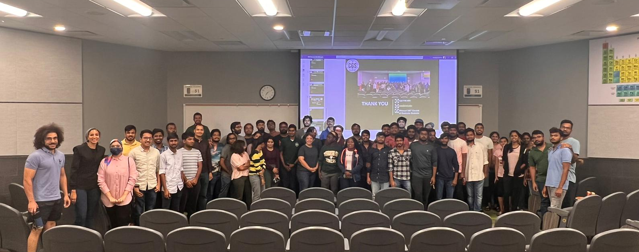
Council of Graduate Students: Elections
For vacant department representative positions
Conducted on Sep 15th
Current Board : 23 members
Still Open : GGPE, MAE, MSE, MS

Slide 17
Council of Graduate Students: Poster Competition
Friendly competition to showcase research to graduate community
Rehearsal for 3MT or for conferences
Great response in the past two years (~40 )
When : November 1 – 4

Slide 18
Agenda
V. Special Topic
Campus Well-Being Initiatives
J. Gargus

Slide 19
Engaging Faculty for Student Success
Notes:
Please do not change location of text boxes, size of text, color of text, shapes, etc

Slide 20
Defining Student Success
Traditional Definition
Expanded Definition
Grades
High academic achievement
Retention
Graduation rates
Career outcomes
Well-being of campus community members
Inclusion in all aspects of university life
Safety of all
Notes:
NORTH STAR GOALS: Attain Carnegie R1 classification; Grow enrollment to 12,000 students: Achieve a top 100 ranking
Pillars upon which student success is possible, much like maslow’s hierarchy

Slide 21
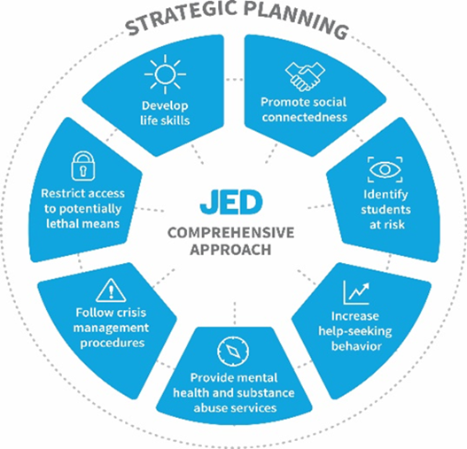
Health and Well-Being Committee
Primary Purpose
Outcomes
Strengthen mental health
Reduce student suicide
Reduce substance misuse
Improved well-being and belonging
Improved retention rates
Improved student success
Notes:
Strategic plan, marketing, assessment, training, policies/procedures, students, faculty engagement - this is in addition to existing services, such as counseling, health promotion , prevention, intervention (SSCS, UCARE)

Slide 22
Role of Faculty in Student Well-Being
“We must not lose sight of faculty members’ primary responsibility to students: effective teaching that leads to meaningful learning. Faculty are experts in their disciplines and, for most, mental health is not their field. Although faculty cannot (and should not) be expected to replace the role of mental health professionals, they can take action as helpers, not clinicians, to support struggling students.”
Association for College and University Educators
Notes:
While instructors are not clinicians, student wellbeing impacts learning and it supports our goals as educators to design with it in mind

Slide 23
Health and Well-Being Data
Mental Health Concerns
Stress of S&T Students
Main mental health concerns:
Major Depression: 56%
Anxiety: 63%
Chronic Sleep Concerns: 26%
Main sources of stress:
School/Academics: 91%
Time Management: 51%
Future Plans: 44%
Mental Health Concerns: 37%
Lack of Friends/Loneliness: 22%
2022 MACHB, n=351
Notes:
2021 - Depression 29%; Anxiety 54%; Sleep 25%
2021 - School 94%; Financial 43%; Time 53%; Future 55%; MH 37%; Reduced time with friends 38%

Slide 24
Health and Well-Being Data
Who Students Go To On Campus With Personal Concerns
 | 2018 PIP 9357 | 2018 S&T 560 | 2019 PIP23 9752 | 2019 S&T 706 | 2020 PIP23 8769 | 2020 S&T 456 | 2021 PIP 10154 | 2021 S&T 415 | 2022 PIP 6705 | 2022 S&T 351
Friends/peers | 78% | 84% | 79% | 83% | 73% | 80% | 65% | 73% | 70% | 77%
Counseling center | 32% | 36% | 44% | 48% | 31% | 39% | 27% | 29% | 29% | 34%
Campus security | 7.3% | 8.6% | 15% | 14% | 3.7% | 5.8% | 2.7% | 2.1% | 4.9% | 6.8%
Academic advisor | 18% | 11% | 31% | 19% | 21% | 16% | 21% | 15% | 20% | 12%
Faculty/professor | 23% | 13% | 35% | 20% | 24% | 15% | 21% | 9.7% | 22% | 14%
Can’t go to anyone | 11% | 9.4% | 6.1% | 5.0% | 12% | 10% | 18% | 16% | 16% | 15%

Slide 25
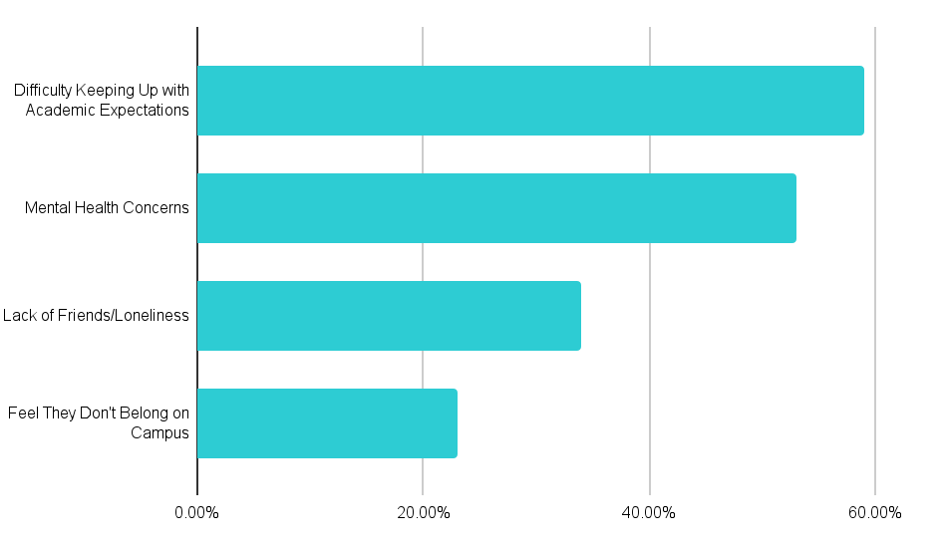
Health and Well-Being Data
Top Reasons for Thoughts of Transferring
21% of S&T students have thought of transferring in the past year
2022 MACHB, n=351
Notes:
2019 American Council on Education study found that students with poor mental health are more likely to have lower GPAs, take longer to complete a degree, or drop out entirely
2016 Danish study found that men with poor mental health were five times more likely to drop out
2012 National Alliance of Mental Illness found that roughly 64% of college students with mental health issues drop out
2009 Healthy Minds Network found that among students who had dropped out with less than a 3.0 GPA, 25% screened positive for at least one mental illness, such as depression or generalized anxiety disorder

Slide 26
Health and Well-Being Data
Key Findings: Faculty’s Role in Student Mental Health
73% have had one-on-one conversations with students in the past 12 months regarding student mental health and wellness. (80% national)
45% of faculty reported that they have a good idea of how to recognize that a student is in emotional or mental distress. (51% national)
66% would welcome additional professional development on the topic of student mental health. (73% national)
Notes:
2021 survey of faculty n=106

Slide 27
Health and Well-Being Data
Key Findings: Faculty’s Role in Student Mental Health
43% believe it should be mandatory that all faculty receive basic training in how to respond to students experiencing mental or emotional distress. (61% national)
26% of faculty agree that supporting students in mental and emotional distress has taken a toll on their own mental health. (21% national)
54% believe their institution should invest more in supporting faculty mental health and wellbeing. (50% national)
Notes:
2021 survey of faculty n=106

Slide 28
JED Phase One Accomplishments
Enhance Academic Partnerships
Identify and train faculty champions
Develop a mental well-being syllabus statement
Create the Health and Well-Being Canvas course
Create and distribute faculty electronic newsletter
Infuse health and well-being activities in FE1100 and Kummer Vanguard Scholars programs
Provide Peer Support to Students At-Risk
Establish peer support groups, Grit and Resilience Workshop
Notes:
As a transitional phrase before reading the slide: So now we see the concerns that students are having, and that how we interact with them has an impact on their overall well-being. Now we will cover the work we are doing and the ways we would love for your and other faculty support

Slide 29
JED Phase One Accomplishments
Improve Awareness and Utilization of Wellness Resources
Designate at FTE to oversee health and well-being communications
Provide Ongoing, Accessible Training for Students
Deliver STEP UP! for Mental Well-Being & resource training during opening week
Create Mental Well-Being Ambassador positions, provide training

Slide 30
JED Phase Two Opportunities
Restructure JED Committee and invite new members
Build faculty website for supporting well-being in the classroom
Explore training tools to enhance faculty interactions with students
Develop Faculty Excellence in Well-Being Award
Distribute monthly email with resources and upcoming events
Partner with CAFE to offer tools and trainings to faculty
Promote health and wellness resources for employees
Expand use of S&T Connect and UCARE
Incorporate well-being metrics into success dashboards
Work closely with New Student Programs and train mentors
Infuse the Inclusive Excellence Framework with JED strategic plan
Notes:
Faculty, students, inclusion, assessment
Drs Glaser, Kimball, Reardon, Baker, Grubbs, Forciniti, Dave Westenberg, Drowne, Wes Lewis, Carol, SImran

Slide 31
Faculty Champions
Expectations
Serve as a point of contact to share information on programs and resources with your department
Be a resource for faculty who have questions about where to send students for support, etc
Participate in a two-hour training and two meetings per semester
Periodic communication with the JED Campus Committee/Faculty Engagement Committee

Slide 32
New Faculty Webpage
What Will Be Featured?
Faculty profiles - share submitted examples of how you support well-being
Actionable practices, examples, tools
Resource library
Support resources for faculty well-being
Notes:
Committee for effective teaching - can this team work on input into this page? Can we continue this discussion, who can work on this?
https://www.umt.edu/curry-health-center/wellness/student-wellness-advocate/faculty-toolkit-book-final-oct-2018-v2-linked-small-updated-updated.pdf
https://www.studentwellness.iastate.edu/wp-content/uploads/2022/05/employee-toolkit-5.10.22-2.pdf
https://www.csustan.edu/health-ed/faculty-staff-wellness-resources/wellness-virtual-classroom-toolkit
https://teaching.uoregon.edu/resources/student-wellbeing-toolkit

Slide 33
New Faculty Webpage
Campus Resources
Employee Assistance Program from ComPsych
Confidential, professional service provided to all employees, their families, retirees, and organizational work units. The EAP provides a variety of services to help employees influenced by a range of personal concerns or stressors.
Call 833.515.0754 (available 24/7)
umsystem.edu/totalrewards/benefits/eap
Notes:
What tools do you need? Kognito?
Use the Quick Reference Guide - distribute
Com Psych?

Slide 34
New Faculty Webpage
Campus Resources
Quick Reference Guide
A one-page document to reference when a student concern arises. The guide is organized by area of concern and level of distress. It is intended to be informational and act as a guide to what resources are available; the guide itself is not therapeutic
wellbeing.mst.edu/resources/well-being-quick-reference-guide
Notes:
What tools do you need? Kognito?

Slide 35
New Faculty Webpage
Tips for Enhancing Student Success
Normalize the need for help
Actively listen with V-A-R
Embed courses with well-being practices
Practice your own self-care and seek resources when needed
Notes:
Validate, appreciate, refer; after going through slide: those are a few ideas of what we want on this webpage
Read well-being syllabus statement out loud
Acknowledge challenges and stressors
Regularly share well-being related slides and ready-made resources in Canvas
Encourage students to take the ALR online training
Create a footnote in email signature with a link to student well-being resources
Offer breaks in class where students can stand, stretch, and breathe
Let students know you care about them and their successes
Build connections between students (small groups, providing prompts, etc)
Use students’ chosen names and pronouns
Set the time of due dates in Canvas with sleep in mind

Slide 36
Open Discussion
New Faculty Webpage- what would you want to see on this page? What would be most helpful?
What does collaboration with Faculty Senate look like?
What other resources could we provide to support your well-being?
How are you already contributing to the expanded definition of student success?
Notes:
Digital technology (Kognito)- a lot of campuses have something like this (online educational material)- would you use this? Talk to virtual students struggling with various mental health concerns, you can learn ways to give support and encouragement, bring up uncomfortable topics, and direct students toward resources
Created by faculty for faculty

Slide 37
Thank You!
Jessica Gargus (gargusj@mst.edu)
Director of Student Well-Being
wellbeing.mst.edu
573.341.4211
204 Norwood Hall

Slide 38
Agenda
VI. Reports of Standing Committees
A. Campus Curricula P. DeWitt

Slide 39
Campus Curricula Committee Mtg
9 August 2022
CCC Meeting -09 August 2022
Total Committee Activity
6 Course Change Requests (CC Forms)
7 Program Change Forms (PC Forms)
6 Experimental Course Request (EC Form)

Slide 40
Campus Curricula Committee Report
22 September 2022
Course Changes (CC) Requested
File: 4882 CIV ENG 6718 : Unsaturated Soil Mechanics
File: 4888 COMP SCI 1911 : Computer Science Concepts
File: 1059.1 MECH ENG 6230 : Theory and Design of Plate and Shell Structures
File: 2639.5 NUC ENG 3221 : Reactor Fluid Mechanics
File: 2371.9 NUC ENG 4496 : Nuclear System Design I
File: 1207.1 NUC ENG 5010 : Seminar

Slide 41
Campus Curricula Committee Report
22 September 2022
Program Changes (PC) Requested
File: 237.24 BIOMED-MI : Biomedical Engineering Minor
File: 14.19 CH ENG-MS : Chemical Engineering MS
File: 153.80 CP ENG-BS : Computer Engineering BS
File: 155.64 EL ENG-BS : Electrical Engineering BS
File: 302.16 MOBLB&T-CT : Mobile Business and Digital Transformation CT
File: 353.4 SPACE R-CT : Space Resources Certificate
File: 303.5 TCH COM-CT : Professional Communication CT

Slide 42
Campus Curricula Committee Report
22 September 2022
For Informational Purposes; No Senate Approval Required
Experimental Course (EC) Requested
File: 4880 COMP SCI 6001.011 : Advanced Virtual Reality
File: 4876 ELEC ENG 6001.007 : Power System Economics and Market Operation
File: 4875 ENGLISH 3001.009 : Vikings: Legends and Lore
File: 4878 HISTORY 3001.008 : Modern Eastern Europe
File: 4879 MIN ENG 6001.004 : Computational Fluid Dynamics for Particulate and Fire Simulations
File: 4877 PSYCH 5001.003 : Organizational Diversity, Equity, and Inclusion

Slide 43
Campus Curricula Committee Report
22 September 2022
Curriculum committee moves for FS to approve the 6 CC and 7 PC form actions.
Discussion: Questions or comments?

Slide 44
Agenda
VI. Reports of Standing Committees
B. Committee on Effective Teaching D. Burns

Slide 45
Committee for
Effective Teaching
Presentation to Faculty Senate
September 21, 2022

Slide 46
Teaching Awards
Teaching awards will be different this year
Outstanding Teaching awards used to be given to the top 10% of qualified instructors on the "Overall Effectiveness" item
Faculty Teaching awards were also given based on a nomination packet (these come with money)
For this year, we eliminated the former and increased the number of the latter
Nominations should include SET scores, but not be based entirely upon them
Applications are due October 14th

Slide 47
Ad Hoc Online Learning Committee
Beth Conception wants to form an ad hoc committee to deal with Online Learning topics, such as:
Quality Course review
Badges and micro-credentials
Faculty training
She asked for 4-5 names of key stakeholders, any volunteers or suggestions?

Slide 48
Committee Agenda for this Year
Make summer evals opt-out instead of opt-in?
Allow chairs to see SET comments?
Have IT create a standardized SET summary report?
Increasing response rates
PEER OBSERVATION!

Slide 49
Peer Observation Framework
Small group of trained evaluators to observe everyone on campus (but not all in one year!) and focus on pedagogy
Pilot program in the spring, campus roll out next fall?
Still need to decide on:
instrument
evaluation frequency
Committee make up/training/compensation
Encourage departments to conduct their own observations that focus on content coverage?

Slide 50
Agenda
VI. Reports of Standing Committees
C. ITCC Perry Koob for Dan Stutts

Slide 51
ITCC Update
September 2022

Slide 52
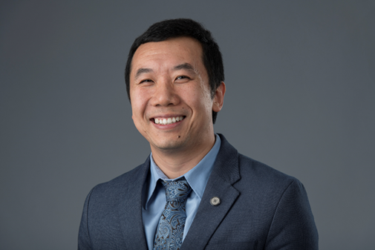
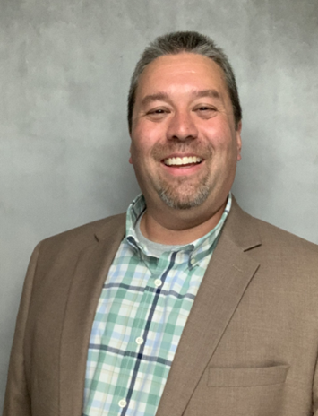
Farewell and Introduction
Farewell and Good Fortune to Danny Tang
We wish him well at his new position at Furman University
Acting Chief Information Officer – Perry B. Koob
Bachelor of Science in Computer Science and Minor in Applied Mathematics, University of Missouri – Rolla
Graduate Certificate in Business Analytics and Data Science, Master of Science in Information Science and Technology, Missouri University of Science & Technology
Twenty-two years supporting the campus information technology needs
Four years adjunct instructor for Computer Science and Business Information Technology
Published research in fields of Information Science, Computer Engineering, and Russian Language

Slide 53
Goals for IT for the next year
Goal 1: | Rebuild the relationship between support staff (us) and customer (you).
Goal 2: | Make getting the right help fast and easy.
Goal 3: | Staff up and staff in strategic areas.
Goal 4: | Get to a place where we can leverage consistent computer models to decrease downtimes.

Slide 54
In support of our Goals
Customer Support (Goal 1 and Goal 2)
Try the IT Support Chat
go.mst.edu/itchat
Moving back to campus to increase access reduce response times.
Electrical and Computer Engineering
Centennial Hall
?
Desktop Enhancement Program (DE) (Goal 4 )
Revisiting structure and funding of the DE Program.
Hiring Staff (Goal 3)
2 opening filled, 9 more to go.
5 strategic positions.
2 senior level staff retiring by end of year.

Slide 55
Follow-up and things to be aware of
Local Administrator Password Tool (LAPS)
it.mst.edu/hardware-software/administrator-privileges/
If you get popups asking for you for admin access, contact us
Change in procedures for Emeritus
Department will get contacted by Emeritus for continuation of Emeritus status

Slide 56
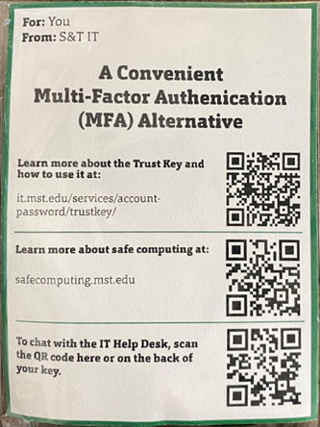
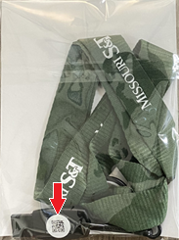
Follow-up and things to be aware of
TrustKey FIDO2 Security Keys
Malicious Actors are working around MFA
Convenient alternative to MFA prompts
Rolled out to Faculty first, will get Staff next
Has QR Code for Chat on the back

Slide 57
Windows 11 Armageddon
The problem S&T is facing:
Windows 10 will reach end of life in October 2025
Unsupported operating systems are a security risk
We have big target on our back as a research university and the Kummer announcement
About half the computers currently on campus are Windows 11 compatible
Computers that are part of the Desktop Enhancement Program, or the CLC and Classroom Replacement Program will be upgraded to a Windows 11 compliant computer by October 2025
There are an unknown number of computers that will not be covered by this or are off campus

Slide 58
Windows 11 Armageddon
What are we going to do about it?
IT is going to collect information on the campus computer and technology inventory and come back to the Deans and Department chairs with an assessment of which computers will be covered and which will not.
IT will work with the Deans and Department chairs to determine what our options are.
IT is going to work with Finance and Operation see about reworking the Desktop Enhancement Program.
What can you do about it?
Work with us when we come to you asking for information about your computer usage.
Work with us to build a clear picture of your needs and help us meet them.
Work with us to determine funding or alternate options for computers that will not be covered by Desktop Enhancement, or the CLC and Classroom Replacement Program .

Slide 59
Agenda
VI. Reports of Standing Committees
D. Budgetary Affairs Mark Fitch

Slide 60
Budgetary Affairs Committee
Sept 22, 2022
Continuing referrals:
Report on the “big picture balance sheet”
Current and next FY budget
Referrals: None, but questions received on
Proposed staff leave change = moot
Hiring allocation/faculty lines
Funding of campus capital projects

Slide 61
Budget this year (no change)
Current FY budget
Enrollment, on campus: -241 UG to 5347; Grad +108 to 980 (Net -1.5% on-campus headcount)
Was -66, +62 so $1 million less tuition than planned = $1 million contingency gone

Slide 62
All Funds Budget FY 2022
All University Funds Dollars in Millions | Actuals
 | FY 2021 | FY 2022* | $ Change | % Change
Operating Revenues
Tuition and Fees | $ 119.7 | $ 120.0 | $ 0.3 | 0.3%
Less Scholarship Allowances | $ 64.3 | $ 71.2 | $ 6.9 | 10.7%
Net Tuition and Fees | $ 55.4 | $ 48.8 | $ (6.5) | -11.8%
Institutional Discount Rate | 53.72% | 59.30%
Federal and State Grants for Scholarships | $ 10.9 | $ 11.1 | $ 0.2 | 2.0%
Institutional CARES Act Funding | $ 19.1 | $ 14.3 | $ (4.7) | -24.7%
Grants and Contracts | $ 37.7 | $ 44.2 | $ 6.5 | 17.4%
Auxiliary and Other Operating Revenues | $ 24.7 | $ 26.5 | $ 1.8 | 7.3%
State Appropriations | $ 50.4 | $ 53.0 | $ 2.7 | 5.3%
Private Gifts and Spendable Investment Income (Internal) | $ 17.0 | $ 27.1 | $ 10.0 | 58.8%
Total Operating Revenues | $ 215.1 | $ 225.1 | $ 10.0 | 4.6%
CARES act $
*Not audited; slides plagiarized from CFO O’Neil

Slide 63
All University Funds Dollars in Millions | Actuals
 | FY 2021 | FY 2022* | $ Change | % Change
Operating Expenses
Compensation
Salaries and Wages | $ 95.7 | $ 96.0 | $ 0.3 | 0.3%
Benefits | $ 29.4 | $ 29.3 | $ (0.0) | -0.1%
Other Operating Expenses | $ 69.1 | $ 74.6 | $ 5.5 | 8.0%
Total Operating Expenses | $ 194.1 | $ 199.9 | $ 5.8 | 3.0%
Net Operating Income | $ 21.0 | $ 25.2 | $ 4.1 | 19.7%
Net Operating Margin | 9.8% | 11.2%
↑ Raises = ↓ People
Depreciation
Carryforward
Profit! Investable!

Slide 64
Where do faculty lines go?
Not lines, recurring money
When a faculty member leaves, 90% to College, 10% to Provost
Change for FY 23
aP: 100% to College
AP: 90% to College, 10% to Provost
P: 80% to College, 20% to Provost

Slide 65
Funding of Campus Capital Projects ($ millions)
Item | Total | Kummer Institute | Gifts | State | Internal
Arrival court | 9.60 | 0.47 | 9.13 | - | -
Site development and relocations | 4.66 | - | 4.37 | - | 0.29
Power plant demo | 3.77 | - | - | 3.77 | -
Underground Parking Garage | 10.23 | 9.23 | 1.00 | - | -
Arrival district total: $28,261,214

Slide 66
Funding of Campus Capital Projects ($ millions)
Item | Total | Kummer Institute | Gifts | State | Internal
Hwy 63 pedestrian underpass | 4.10 | - | - | - | 4.10
Innovation Lab | 37.72 | 20.66 | 7.50 | - | 6.51
Protonplex | 96.25 | 50.00 | - | 46.25 | -
Rolla Building | 1.95 | - | - | - | 1.95

Slide 67
Funding of Campus Capital Projects ($ millions)
Item | Total | Kummer Institute | Gifts | State | Internal
Substation Relocation | 11.15 | - | - | 0.91 | 10.24
University Drive/ Roundabout | 4.28 | - | - | - | 4.28
Welcome Center | 25.75 | 12.88 | - | - | 12.88
Grand total: $265,285,829 98,352,155 22,000,000 50,933,584 41,733,322

Slide 68
Funding of Campus Capital Projects ($ millions)
Item | Total | Kummer Institute | Gifts | State | Internal
KI Conference Room | 2.16 | 2.06 | - | - | 0.10
Office space | 0.55 | - | - | - | 0.55
Safety and Code upgrades | 0.84 | - | - | - | 0.84
Parker Hall total: $3,560,357

Slide 69
Agenda
VII. New Business

Slide 70
Agenda
VIII. Adjourn
70

